Slide 1

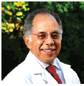

“I Have No Financial Disclosures”

Slide 2
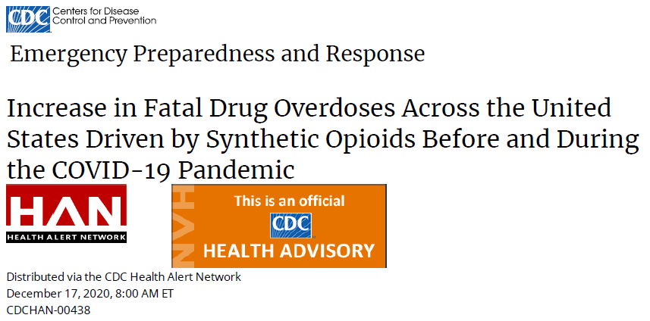
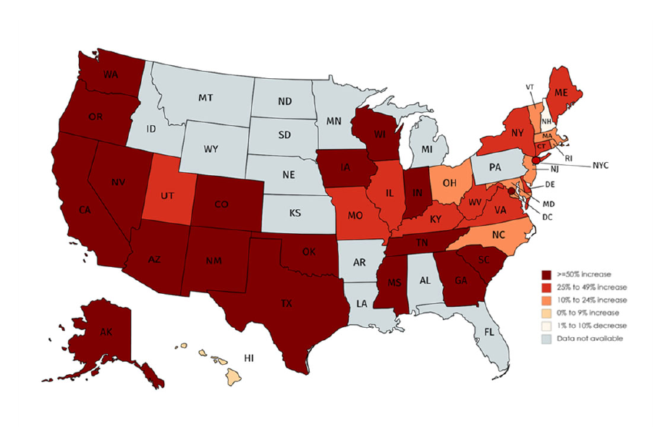
50% INCREASE in
OVERDOSE DEATHS
DUE to SYNTHETIC
OPIOIDS (FENTANYL)

Slide 3

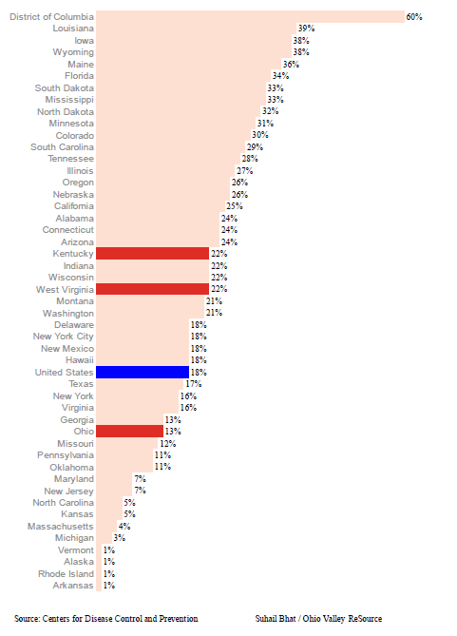
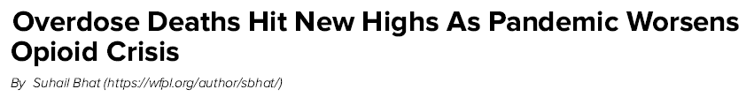
COVID 2020

Slide 4
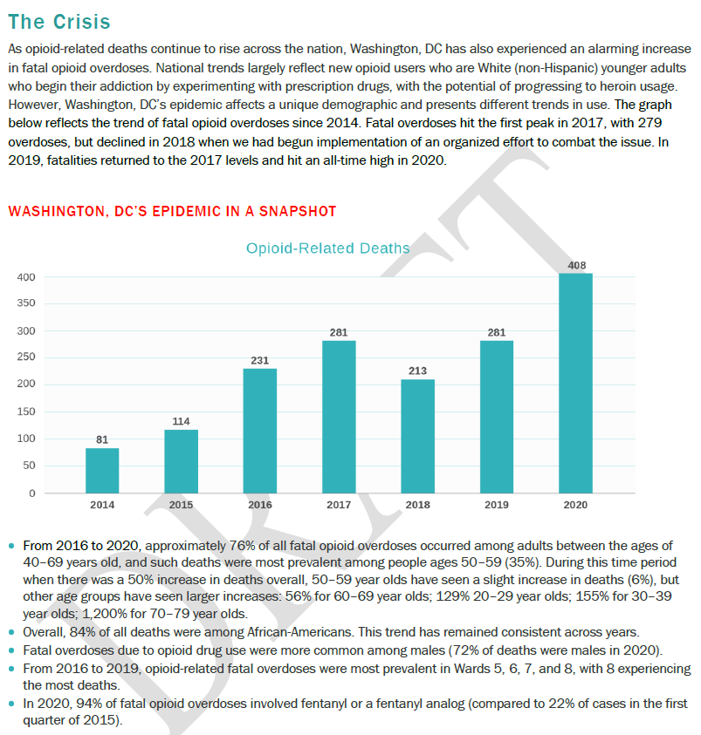
20% FENTANYL 94%

Slide 5

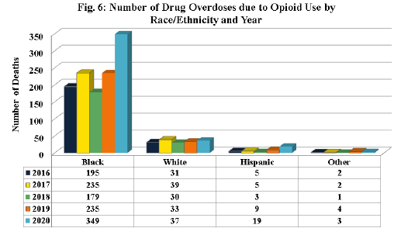
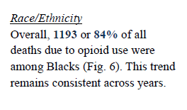

Slide 6
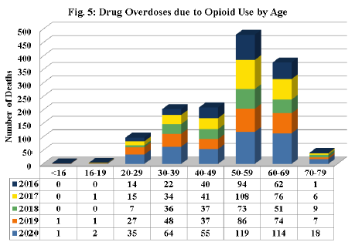
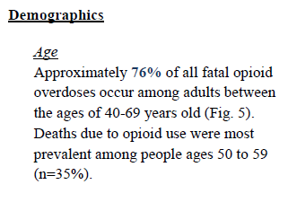

Slide 7
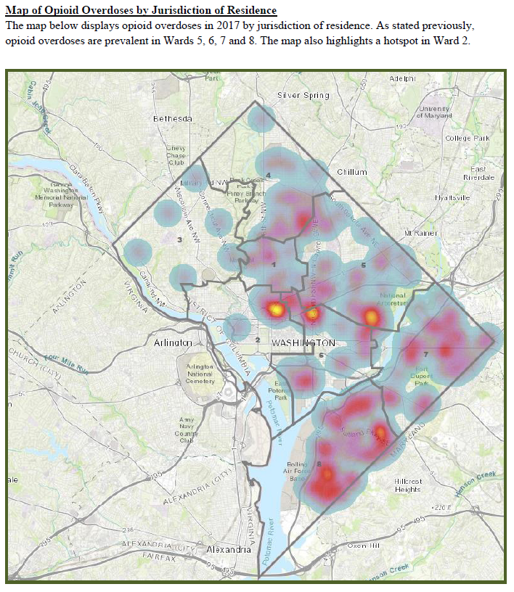
CHAPMAN, MD, PC
WEST
EAST

Slide 8
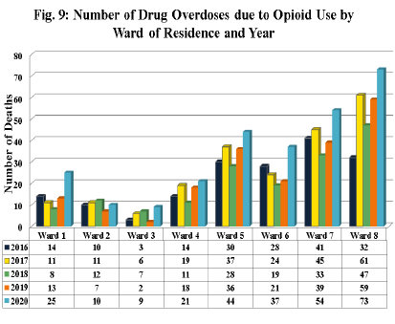
Disproportionately Black
WEST
EAST
Disproportionately White

Slide 9
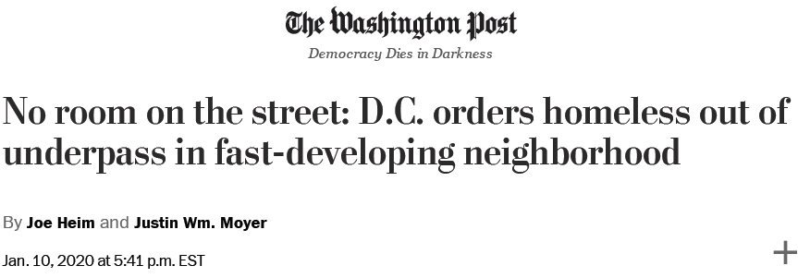
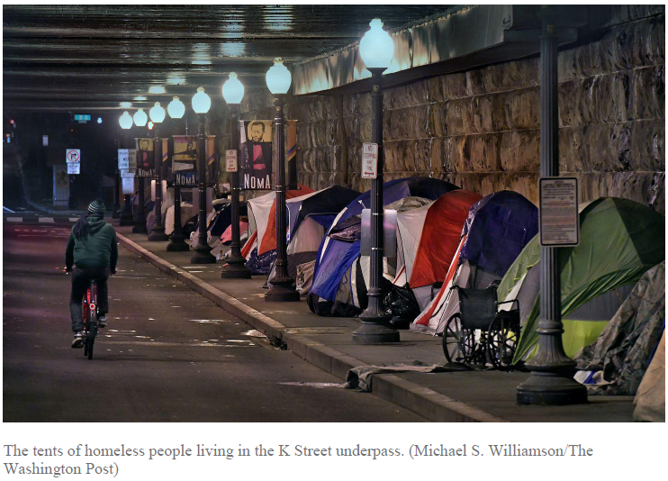

Slide 10
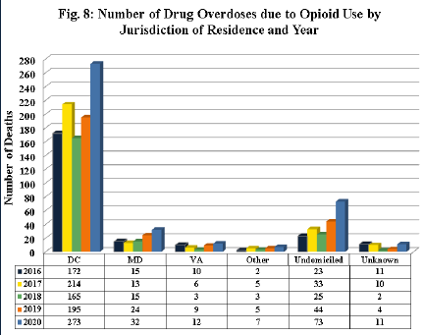
HOMELESS with OPIOID USE DISORDER:
DEATHS 2016-2020
200%

Slide 11
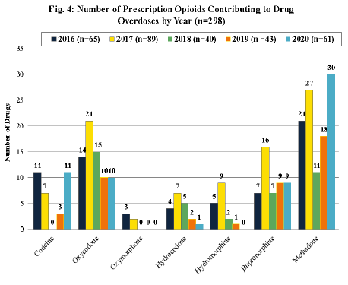
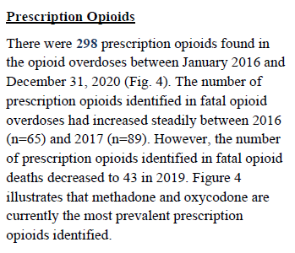

Slide 12
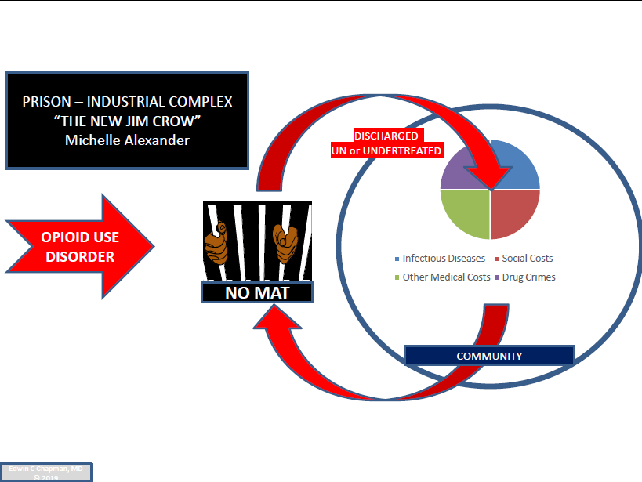
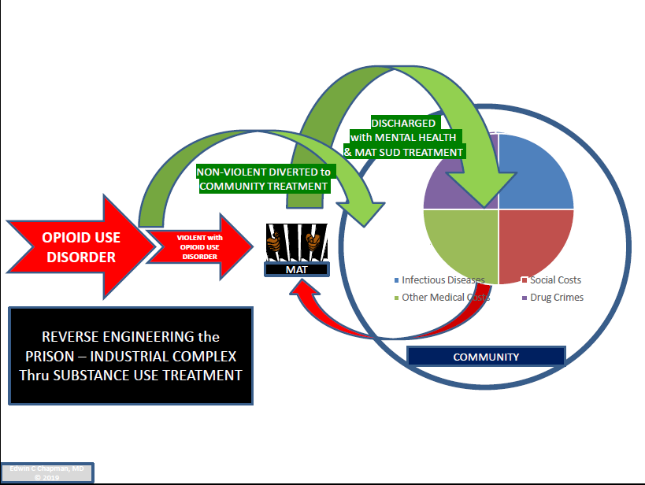
REVERSE ENGINEERING 401 YEARS of SYSTEMATIC OPPRESSION
MASS INCARCERATION
COMMUNITY REINTEGRATION

Slide 13
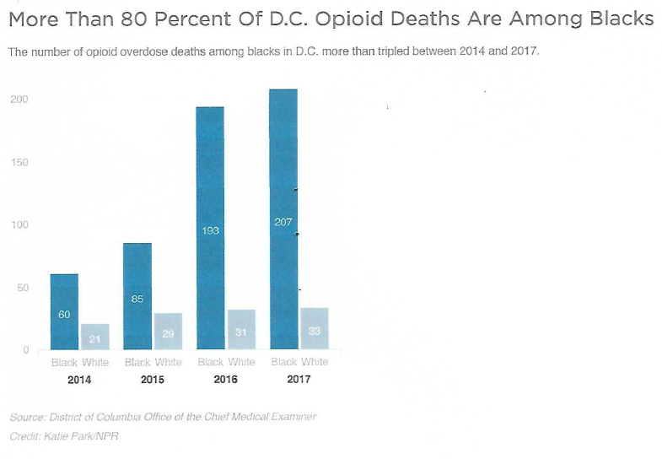
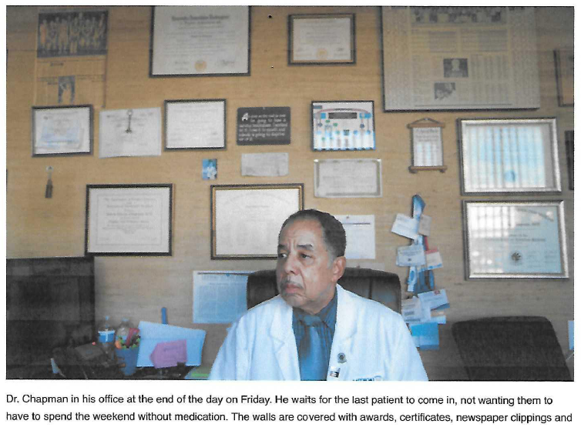
CHAPMAN, MD, PC
230 Current Patients on Buprenorphine:
n
p
r

Slide 14
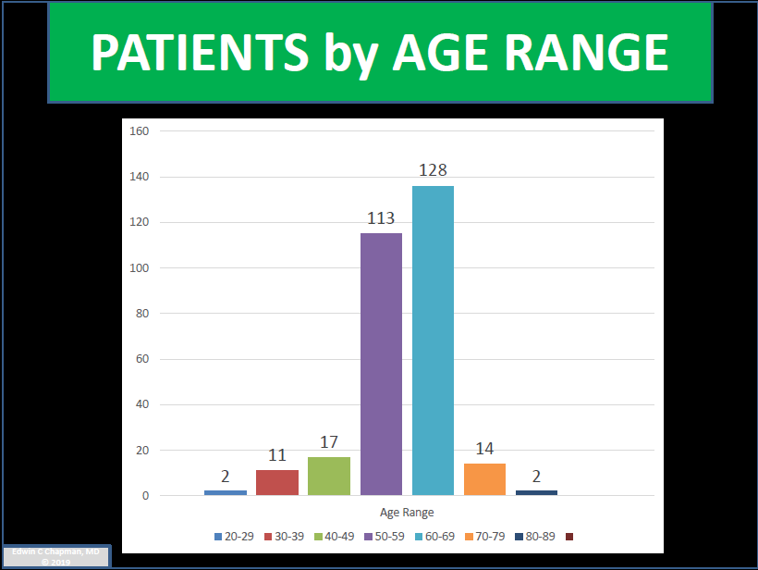

Slide 15
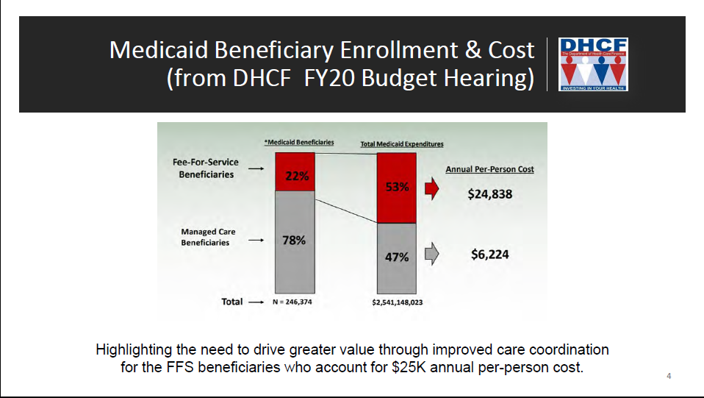
WASHINGTON, DC as a Generic Exemplar

Slide 16
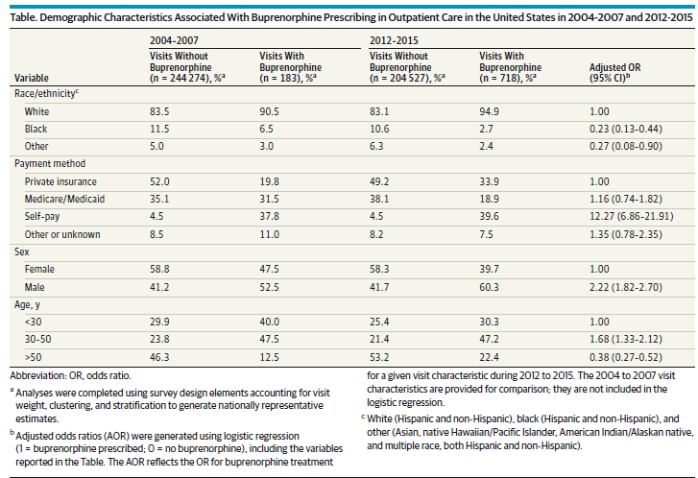
BUPRENORPHINE MEDICATION DIVIDE

Slide 17
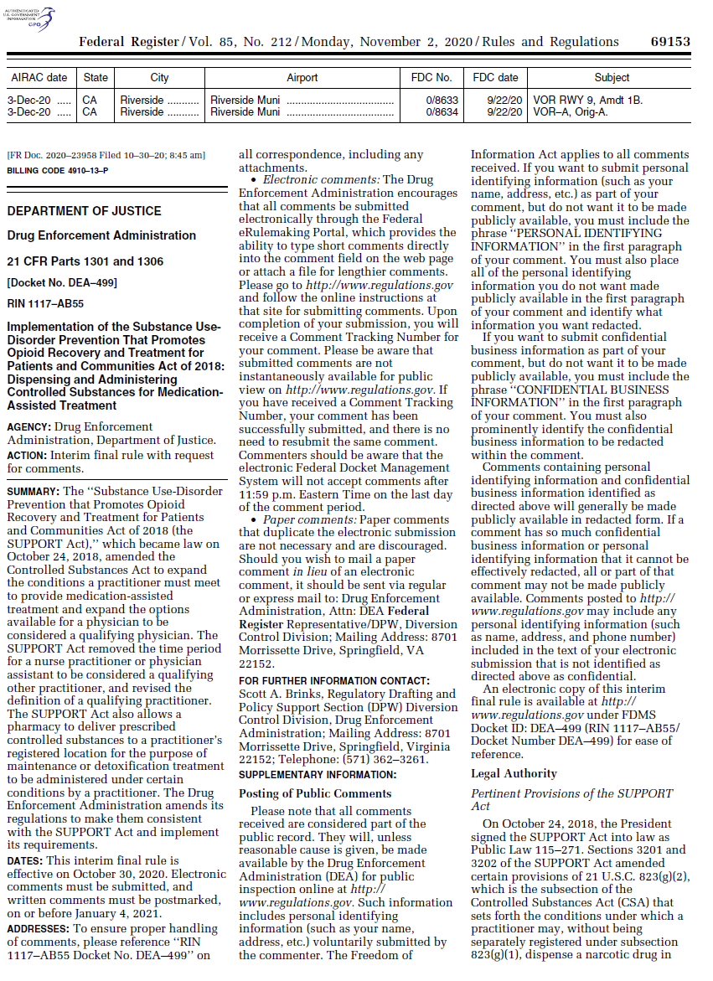
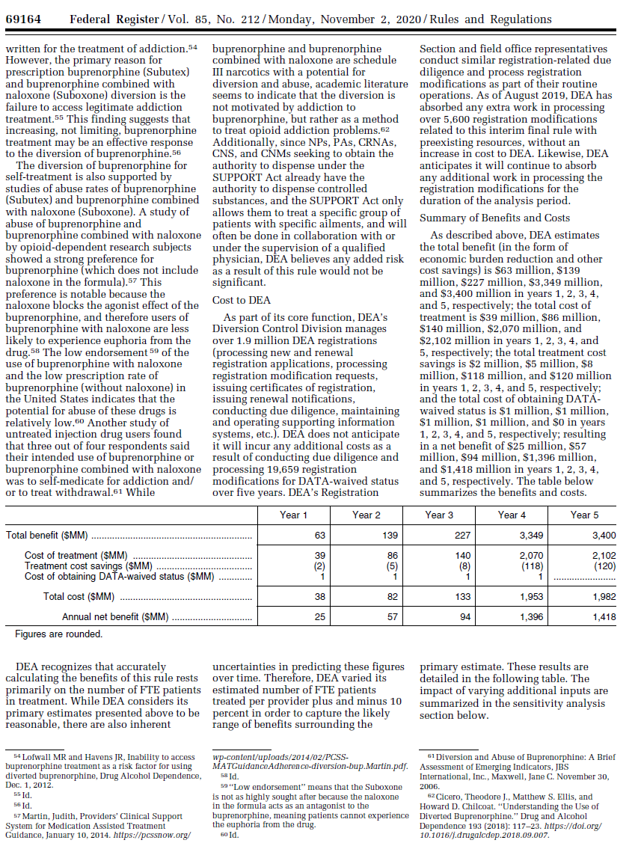
Federal Register November 2, 2020
ANNUAL NET SAVINGS to the FEDERAL GOVERNMENT by EXPANDING BUPRENORPINE TREATMENT NPs, PAs, etc

Slide 18
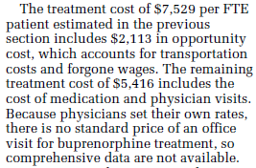
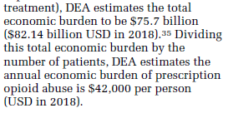
$7,500
ANNUAL
BUPRENORPHINE
TREATMENT
COST
SAVES MONEY
$42,000
UNTREATED ANNUAL MEDICAL COSTS
Edwin C. Chapman, MD, PC © 2021

Slide 19
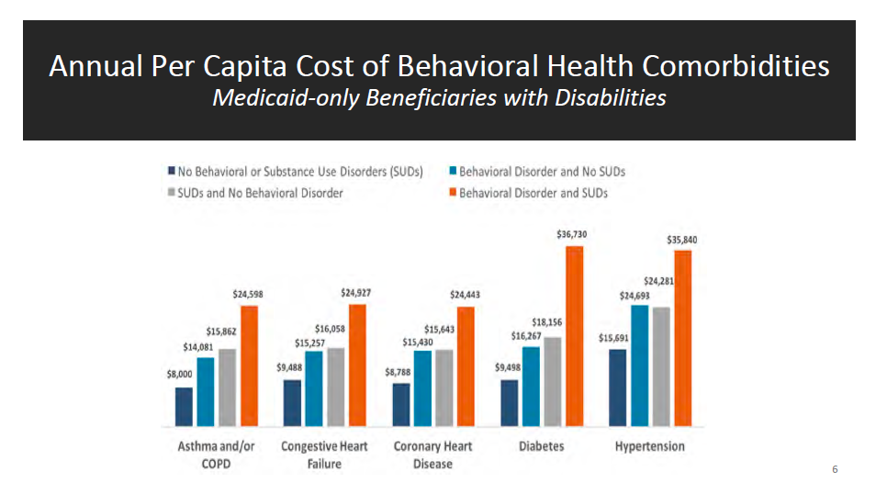

Slide 20
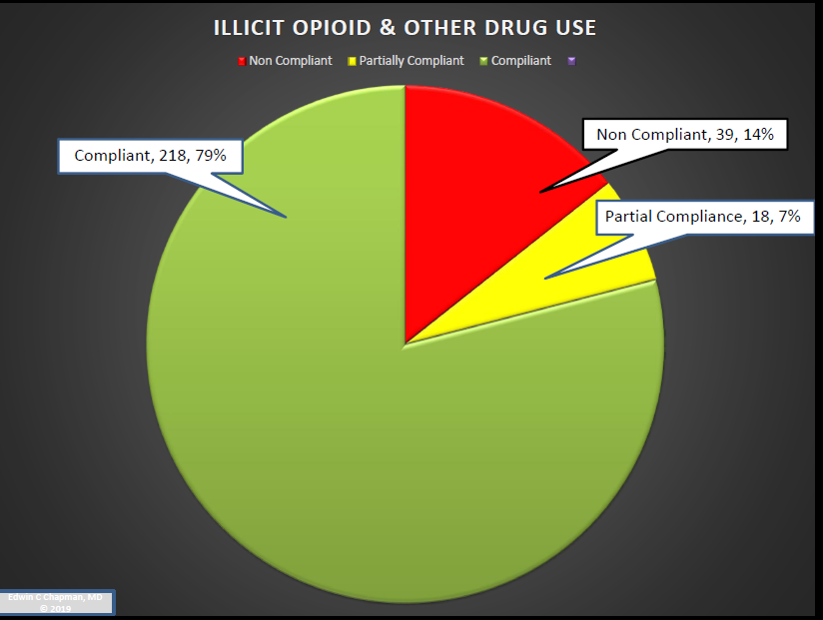

Slide 21
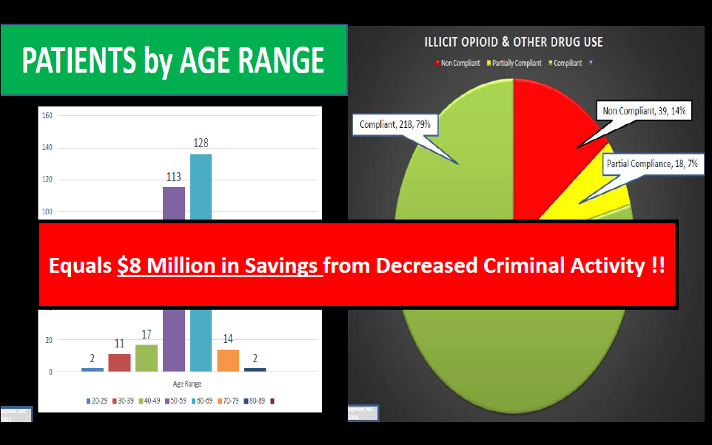

Slide 22
TOTAL IMPACT of an INDIVIDUAL PATIENT on COMMUNITY
UNTREATED PATIENT
PATIENT IN TREATMENT
INCREASED
JAIL &
CRIMINAL JUSTICE COSTS
INCREASED ED & HOSPITALIZATION HIV & HEP C COSTS
INCREASED COMMUNITY CRIME, UNEMPLOYMENT POOR SCHOOL PERFORMANCE, FAMILY DYSFUNCTION
DECREASED
JAIL &
CRIMINAL JUSTICE COSTS
DECREASED ED & HOSPITALIZATION HIV & HEP C
COSTS
INCREASED MAT
OPIOID
DRUG
Rx
DECREASED COMMUNITY CRIME, UNEMPLOYM’T, POOR SCHOOL PERFORMANCE, FAMILY DYSFUNCTION
$35K
Criminal Costs
SILOED COSTS
Every $1 Spent on Treatment Saves $7
$50-60K
With Rx
TOTALCOST
$112K
$42K
$35K
COST SAVINGS
Medical Costs
Social Costs
EDWIN C CHAPMAN, MD © 2017

Slide 23
HARM REDUCTION-LOSS MITIGATION MODEL using
MEDICATION for OPIOID USE DISORDER (MOUD)
UNITERUPPETED DRUG USE
NO TREATMENT = $112K TOTAL COST
Criminal
Justice
$35K
Social
Economic
$35K
SIGNIFICANTLY REDUCED DRUG USE
HARM REDUCTION with MOUD = $52K NET SAVINGS
Criminal
Justice
$10K
Social Economic
$30K
Criminal
Justice
$0
Medical &
SUD
$42
Medical &
SUD
$20K
NO DRUG USE
COMPLIANT with MAT = $62K NET SAVINGS
Social
Economic
$30K
Medical &
SUD
$20K
Edwin C. Chapman, MD
Chief Medical Officer
Medical Home Development Group
© 2018

Slide 24
RYAN WHITE CARVEOUT
KNOWLEDGABLE
SPECIALTY
NETWORK
$
$

Slide 25
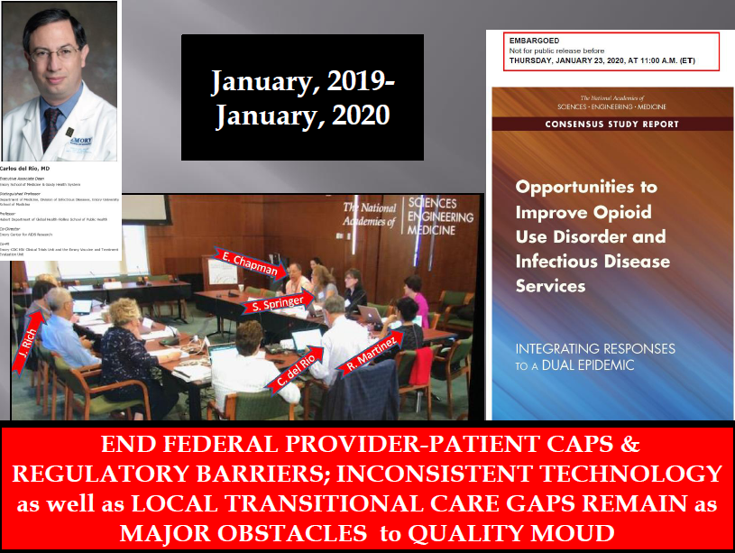

Slide 26
MOUD TREATMENT CARVEOUT
KNOWLEDGABLE
SPECIALTY
NETWORK
$
$

Slide 27
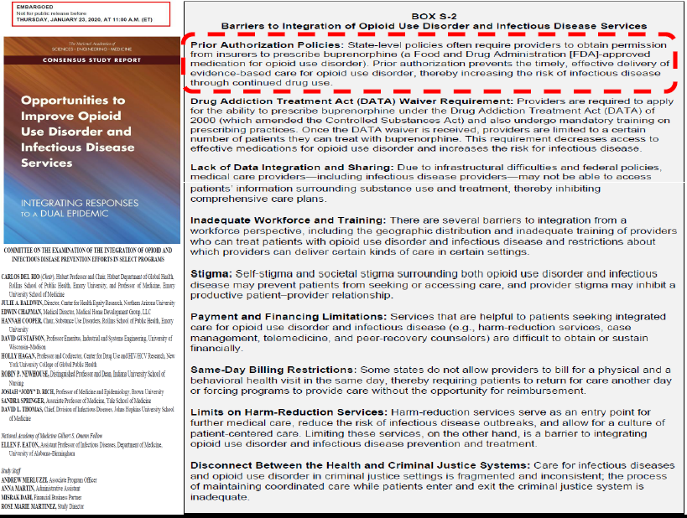

Slide 28
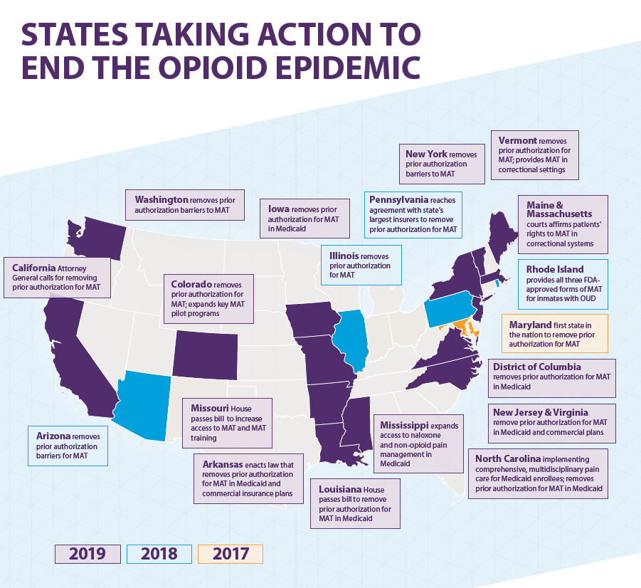


Slide 29
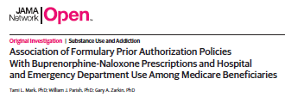
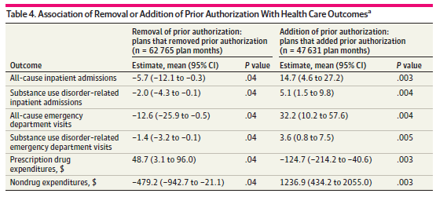
PRIOR AUTHORIZATIONS for BUPRENORPHINE IMPEDES ACCESS to CARE
and
INCREASES ED VISITS and HOSPITALIZATIONS

Slide 31
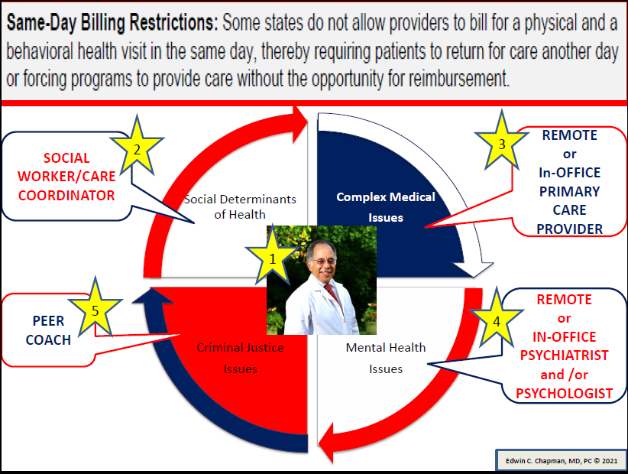


FRAGMENTED PAYMENT SYSTEM IMPEDES VALUE-BASED CARE
OFFICE BASED MOUD

Slide 32
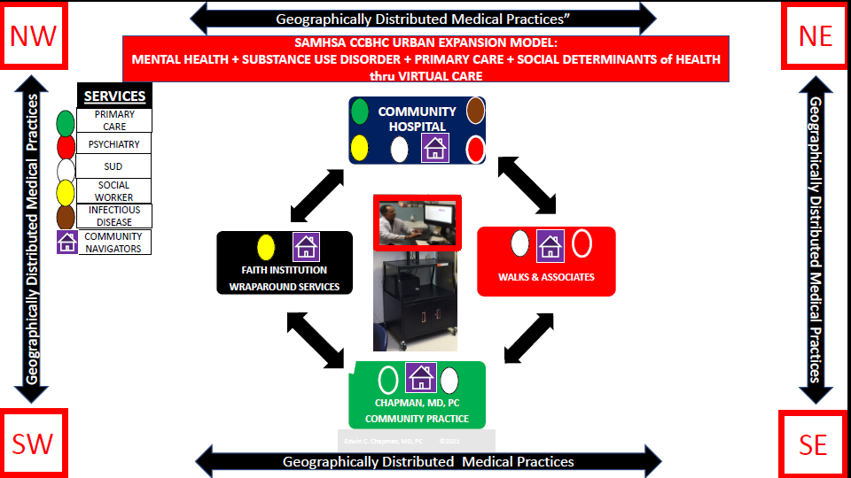

Slide 33
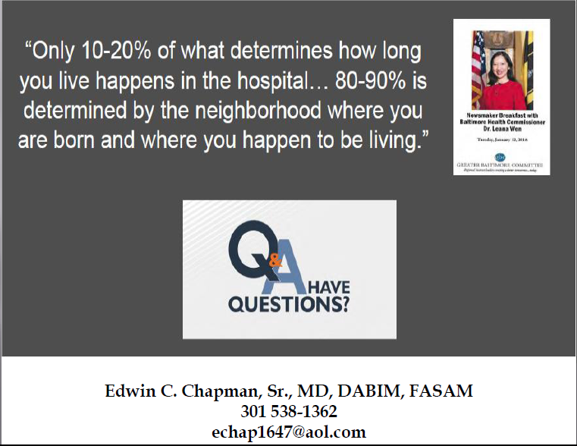
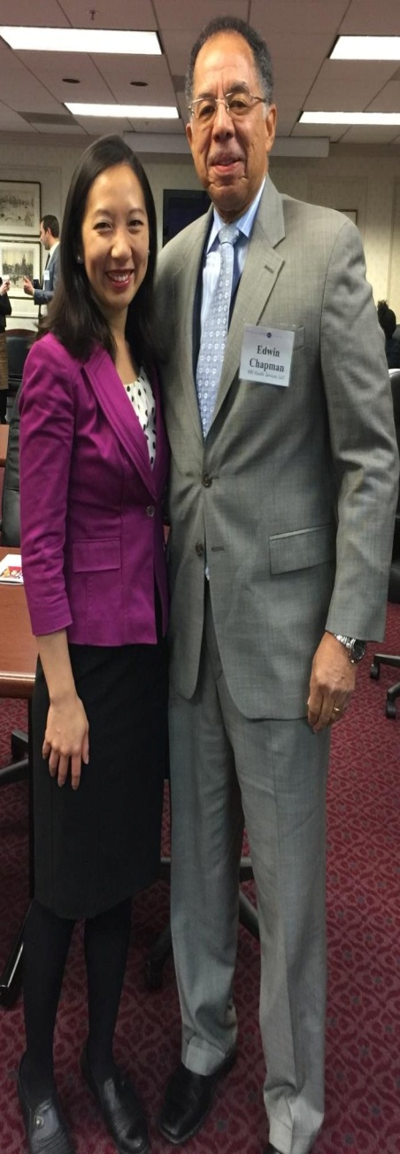
LEANA WEN, MD, MPH
FORMER BALTIMORE COMMISSIONER of HEALTH
February 2016

